Slide 1
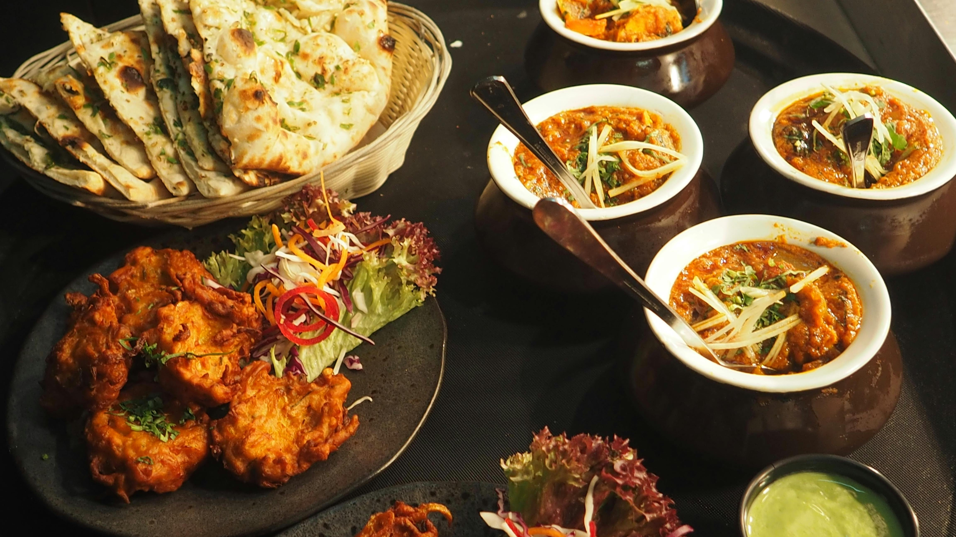
Foodie Heaven

Slide 2
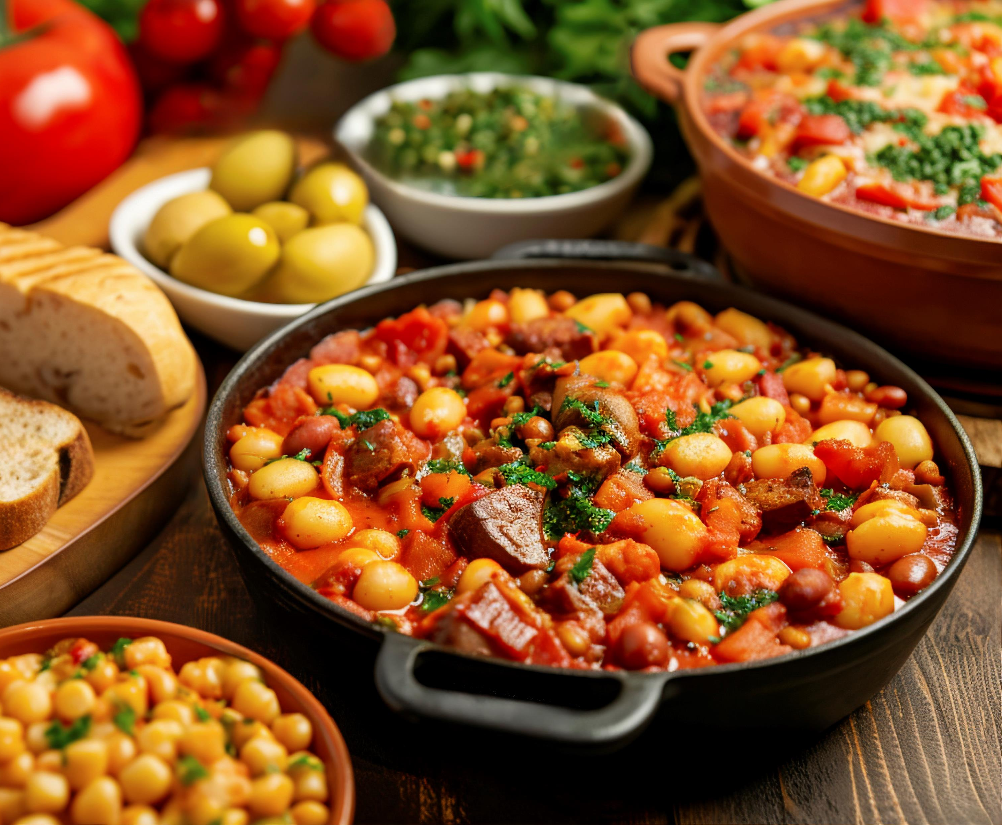

CONTENTS:
PROJECT SUMMARY
INTRODUCTION
STATEMENT OF THE PROBLEM
OBJECTIVES
SCOPE
METHODOLOGY
LITERATURE REVIEW
REQUIREMENT
FEASIBILITY
RESEARCH FINDINGS
CONCLUSION

Slide 3
PROJECT SUMMARY
Title : Foodie Heaven
Aim : To Manage Food Orders and Deliveries Efficiently
Developed at : New Summit College
Development Platform : Android
Front-end-tool : XML, Android Studio
Back-end-tool : Kotlin, Firebase, Imgur

Slide 4

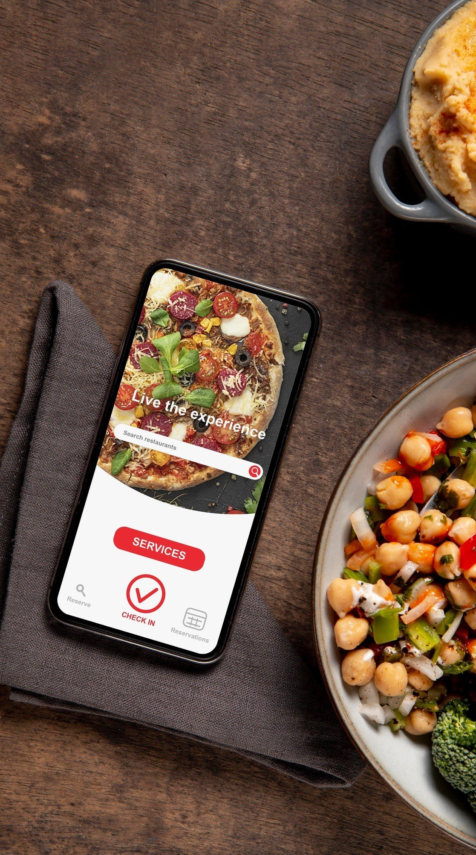
INTRODUCTION
Foodie Heaven is a digital platform for ordering food online.
Suitable for restaurants, fast food chains, and home kitchens.
Customer can search for the availability of foods at any moment.
Firebase for backend services, ensure data security, minimize loss of data.

Slide 5

STATEMENT OF THE PROBLEM
People have limited time to prepare meals at home due to busy lifestyles.
Traditional food ordering methods can be slow & frustrating.
There is a need for a user-friendly app that allows users to order food conveniently .

Slide 6

OBJECTIVES
To Develop a mobile application with an easy-to-navigate interface.
To Enable quick order placement with minimal user input.
To Provide basic search and filtering options to help users find dishes.
Keep a simple record of users’ past orders for easy reordering.

Slide 7

SCOPE
User registration and login
Browsing restaurant menus with pictures and descriptions
The app will use a lightweight database (e.g. Firebase) for managing local data.
A simple user profile will store preferences and order history.

Slide 8


LITERATURE REVIEW
Foodmandu
Bhojdeals

Slide 9
FUNCTIONAL REQUIREMENT
The customers should be able to register and login into the system.
Users should be able to browse food items, view menus, and place orders.
The admin shall be able to update, edit and view the order status.

Slide 10
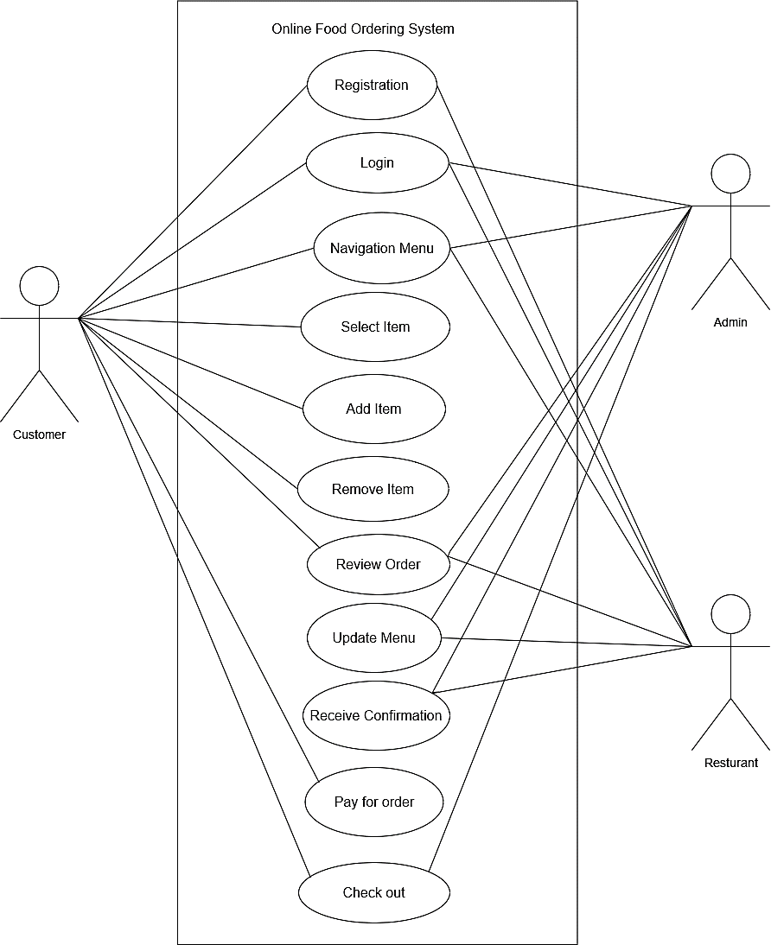
Use Case Diagram of Online Food Ordering

Slide 11
NON-FUNCTIONAL REQUIREMENT
The system is secure which lets only authentic users.
Simple, user-friendly, and attractive to users.
The architecture of this system is highly optimized and well managed.
It is a light application that uses minimum bandwidth and provides high-speed accessibility.

Slide 12
FEASIBILITY ANALYSIS
Technical Feasibility :
Developed using Java or Kotlin for Android. Hardware and software readily available.
Operational Feasibility:
User Friendly design.
Easy to use for customers and admins.
Economical Feasibility:
Minimal cost

Slide 13
GANTT CHART
Working Time | 08th Aug | 8th Sept | 19th Sept | 30th Oct | 01thDec | 06th Dec
Planning
System Design
Implementation
Testing
Maintenance
Documentation

Slide 14
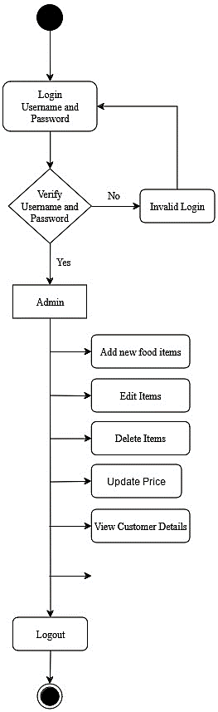
Admin Activity Diagram

Slide 15
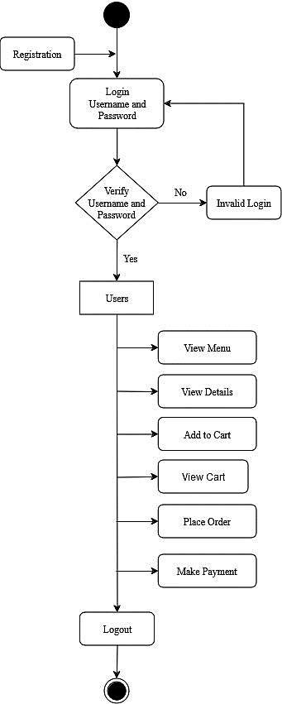
Customer Activity Diagram

Slide 16
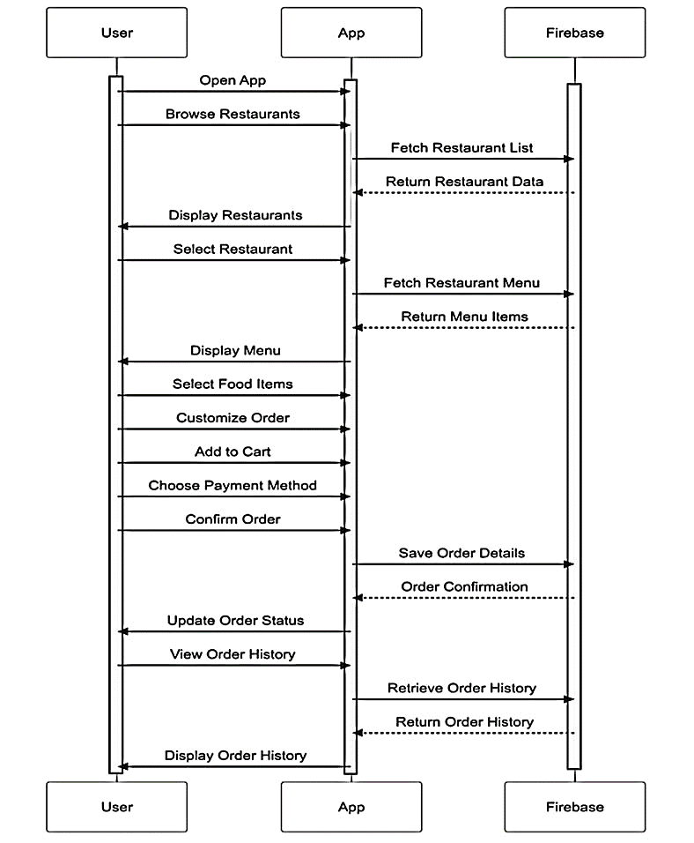
Sequence Diagram

Slide 17
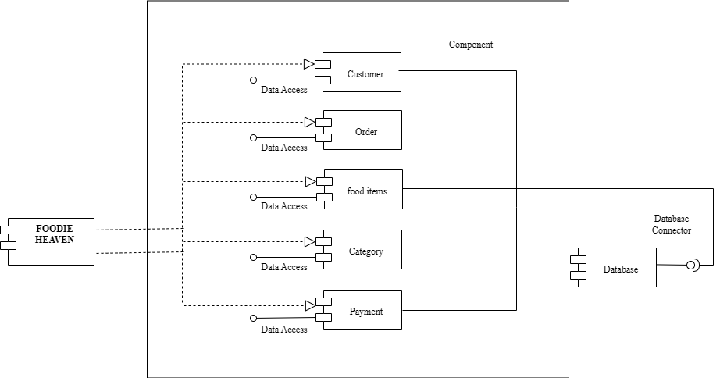
Component Diagram

Slide 18
Implementation of Content Based filtering :
Cosine Similarity Calculation:
fun getCosineSimilarity (ingredients1: String, ingredients2: String): Double {
// Convert ingredients to lower case word & splits the string into individual word
val words1 = ingredients1.lowercase().split(Regex("[,\\s]+")).toSet()
val words2 = ingredients2.lowercase().split(Regex("[,\\s]+")).toSet()
// Calculate common ingredients
val intersection = words1.intersect(words2).size.toDouble()
// Calculate magnitudes
val magnitude1 = sqrt(words1.size.toDouble())
val magnitude2 = sqrt(words2.size.toDouble())

Slide 19
// Compute similarity score
return if (magnitude1 * magnitude2 == 0.0) 0.0
else intersection / (magnitude1 * magnitude2)}
Example:
val pizza = “tomato, cheese, onion”
val pasta = “tomato, chilly, onion”
// High similarity score because they share “tomato” & “onion”
Formula:
Cosine Similarity = intersection size / ( magnitude1 *magnitude2 )

Slide 20
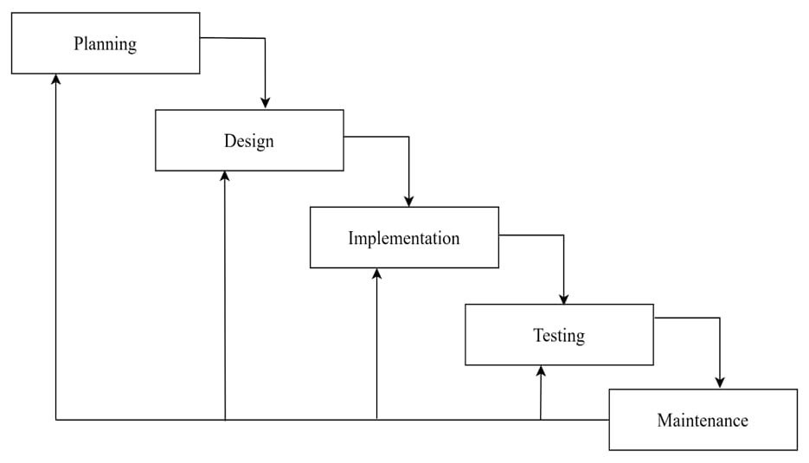
METHODOLOGY
Waterfall model used as development methodology.
Best suited for projects with clear and fixed requirement.
Phases completed in strict, sequential order.
Minimal customer involvement.

Slide 21

CONCLUSION
Used modern technologies : Android Studio, Kotlin, Imgur and Firebase.
Addresses limitations of Traditional Ordering System.
Enhances convenience for customers and restaurant admin.
Meets user specifications and market needs.
Potential for future enhancements and market growth.

Slide 22

OUTCOME
Creation of a seamless platform for managing food orders and deliveries.
Implementation of an user-friendly interface for enhanced user experience.

Slide 23

FUTURE RECOMMENDATION
Payment Integration with eSewa, Khalti, and IME Pay.
Enhance Food Search with auto complete text suggestion.
Integrate with Google Map fro precise location.
User reviews and ratings.
Loyalty Programs and Promotions.
Security Features.

Slide 24
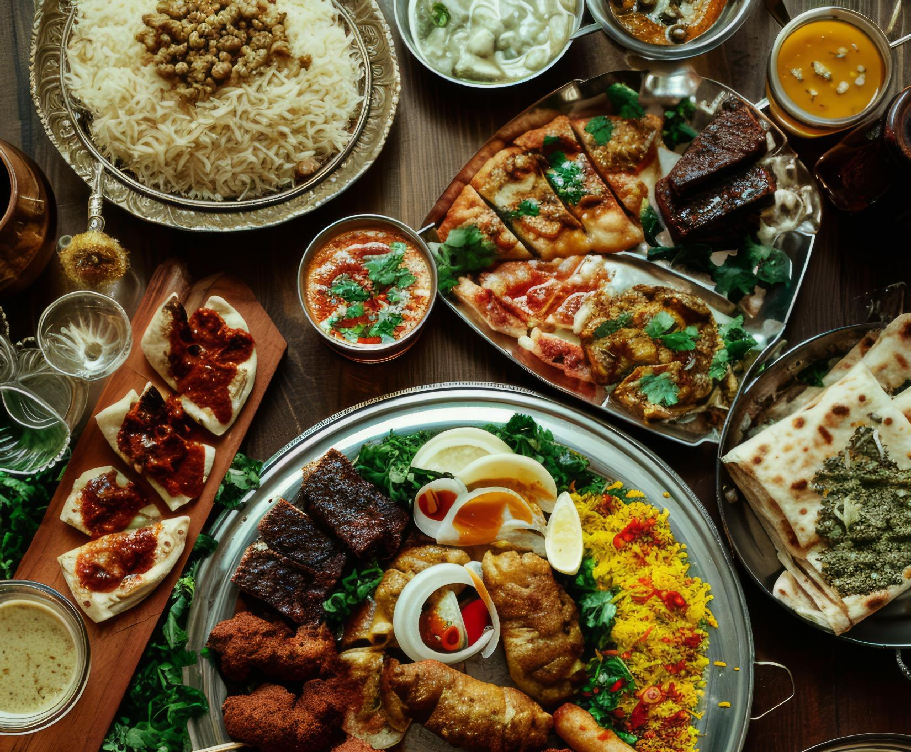

THANK
YOU
ORDER RIGHT NOW

